Slide 1
WFLTA Moving from Novice to Advanced Using Project based learning wflta.weebly.com
October 8 &9 2015
Martha Halemba
peromartha@gmail.com

Slide 2
Reaching Intermediate and advanced
Choose a level that you are teaching and write the specific goals that you have for them this year.
Do your students have the same goals?
Most have no idea what an intermediate or advanced looks like. Minimum work for a grade
ODE Rubrics
OFLA Rubrics
New Jersey Rubrics

Slide 3
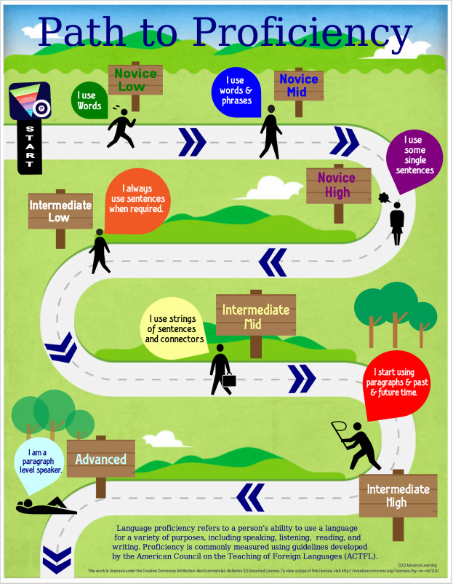
Students need a road map
Success =
Be engaged
Be responsible for self and peers
Be prepared
Be kind
Español 3
Señora Halemba
halembam@hudson.edu
Proficiency Target
Intermediate Low
90% in spanish
Language is not perfection.
It is spiraled and learned
over time.
All students can learn Spanish!
Assessments
Formative
interpretive
interpersonal
presentational
Summative
Integrated Performance Assessment (IPA)
interpretive
interpersonal
presentational
vocabulary usage in context
grammar usage in context
grammar usage in context

Slide 4
Spiraling
This is not linear learning
They expect to
study-forget-study-forget
Must continue spiraling
You begin advanced in novice

Slide 5
Strategies to get students involved and engaged
Self-assess and create goals
Show them what they should be striving for
Push them out of their comfort zones
If you only stay in the novice or intermediate , they will only stay there
Students do the minimum for a grade

Slide 6
Project based learning

Slide 7
Buck Institute for Education
With a partner, write what you know about project based learning.
Project based learning
Project Based Learning is a teaching method in which students gain knowledge and skills by working for an extended period of time to investigate and respond to an engaging and complex question, problem, or challenge.

Slide 8
Essential Elements
Key Knowledge, Understanding, and Success Skills
Challenging Problem or Question
Sustained Inquiry
Authenticity
Student Voice & Choice
Reflection
Critique & Revision
Public Product

Slide 9
Start small with Integrated Performance Assessments students aren’t used to choice and grey areas. Want black and white
Move to PBL that is somewhat structured
Move to PBL that is inquiry based on interest or essential questions
Notes:
The farther you go up, the more language they need.

Slide 10
Topic to spiral: How do we stay healthy and how can we help the world stay healthy?

Slide 11
For all levels
give list of connecting words
novice-minimal
intermediate-more
advanced-even more and ideas to keep on hand
scaffold written work
Use Venn Diagrams tú y yo
Venn upper level
Use topic sentence ahead of time – student sample
interpersonal- formative have list of expressions, etc. available
Use a few handy sayings

Slide 12
Never trust Google Translate!

Slide 13
Level 1 Novice
Essential questions
What do you like to eat?
What is good for you to eat? and bad?
What does the national “My Plate” suggest you eat?
List the things you might want to teach to help students reach these understanding in your language.

Slide 14
Teach
Foods both local and international
Verbs to talk about the foods
Shopping list
I like…. I don’t like….
Food comparisons with classmate
Mi plato vs pirámide
Questions for mi plato
Example of formative quiz

Slide 15
Level 2 Novice Intermediate
Essential questions
What exercise would benefit me?
What options do I have once I am out of school?
What are some good examples that would help me be a healthy person in life?
What would you need to teach?

Slide 16
Teach
Activities. Activities 2
dances
recommendations for activity per day
Fitbit (español)
Fitbit (Deutsch)
Recommendations for exercise

Slide 17
Level 3 Intermediate
Essential questions
How do I feel about my health and those in other countries?
What can I do if I get sick in another country?
How can I help people from other countries stay healthy?
What would you teach?

Slide 18
Teach
World Health Organization
Benefits from exercise
Commands
vocabulary for illness
Campfire stories

Slide 19
Level 4 Intermediate
Essential questions
What are some of the health issues that teenagers are struggling with in the United States?
What are some of the health issues that teenagers are struggling with around the world?
What would you teach?

Slide 20
Teach
Skills for researching on the Web
How to make a personal vocabulary list
Provide useful words page
Provide open ended essential questions for study
Incorporating more complex grammar concepts like subjunctive
Articles of interest
Favores
Bajo de peso 1, Bajo de peso 2, Bajo de peso 3
Bullying
circumlocution

Slide 21
Advanced
Pick a topic to investigate– must be broad
Use only sources in the target language
Create own vocabulary learned list
Work with one (or however many you choose to have in a group)
Use advanced grammar with opinions that are backed up with information.
Present at the end (examples)
Debate
Informational presentation
Documentary movie

Slide 22
ACTFL Proficiency Guidelines
Work with partner
Go from Novice to Intermediate or Intermediate to Advanced
Note the differences
Write down some strategies you might use

Slide 23
Thank you!!
Collaborate—Share sources and ideas
Ohio Department of Education
OFLA Weebly

